Slide 1

DriverPass System Analysis
Logan Parker
Notes:
[No speaker notes required for this slide.]
6

Slide 2

Functional Requirements:
The system will create driving instruction appointments
The system will administer lessons
Non-functional Requirements:
The system will be available from any location
The system will have the ability to be used by many users simultaneously
System Requirements
Notes:
Finding appropriate requirements is key to making software that will behave the way that one might expect. The requirements I chose to outline here are key pieces of this puzzle, but really they only scratch the surface. The first requirement I chose was “The system will create driving instruction appointments.” This one may seem obvious, but it is important. The next is “The system will administer lessons.” These two functional requirements are very important to include, as they are key features that the system needs.
For the non-functional requirements I chose to present “The system will be available from any location.” This means any device that can access the server should be able to use the system. Additionally I chose “The system will have the ability to be used by many users simultaneously.” This is key, because if the system cannot handle multiple users then it will not be useful to many people.
6

Slide 3
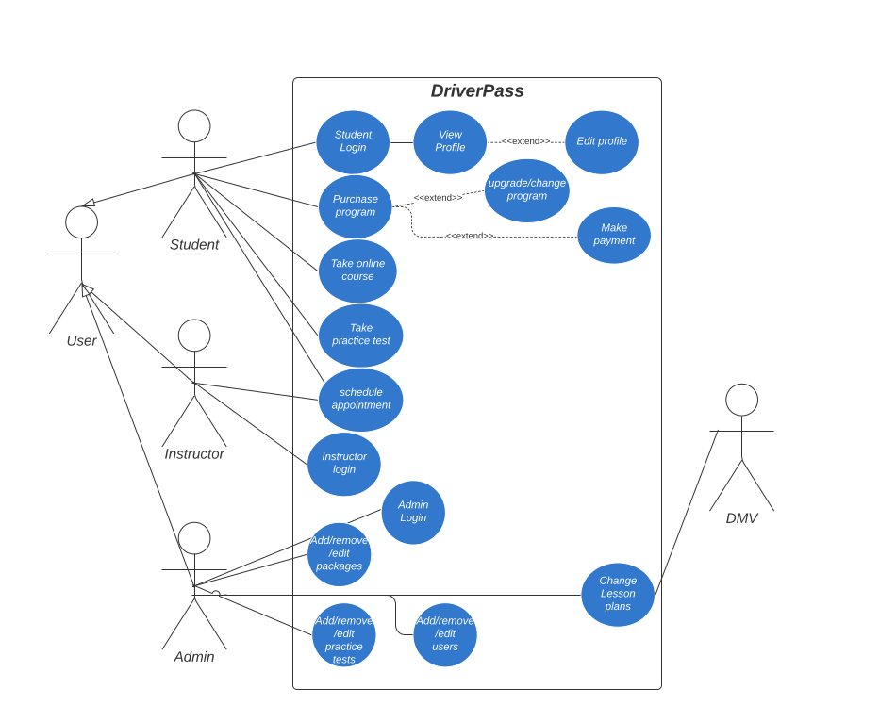
Use Case Diagram
Notes:
In this diagram you can see what kind of people and systems will be using our system. Here you can see we have Users, who can be 3 different types: Student, Instructor, Admin. These people can do various things in the system according to the type of user they are. For example the user can sign up for an driving instruction appointment, and so can the Instructor. You can also see on the right there is the DMV. Their system will let ours know when content needs updating. This is one of the key features you requested.
6

Slide 4
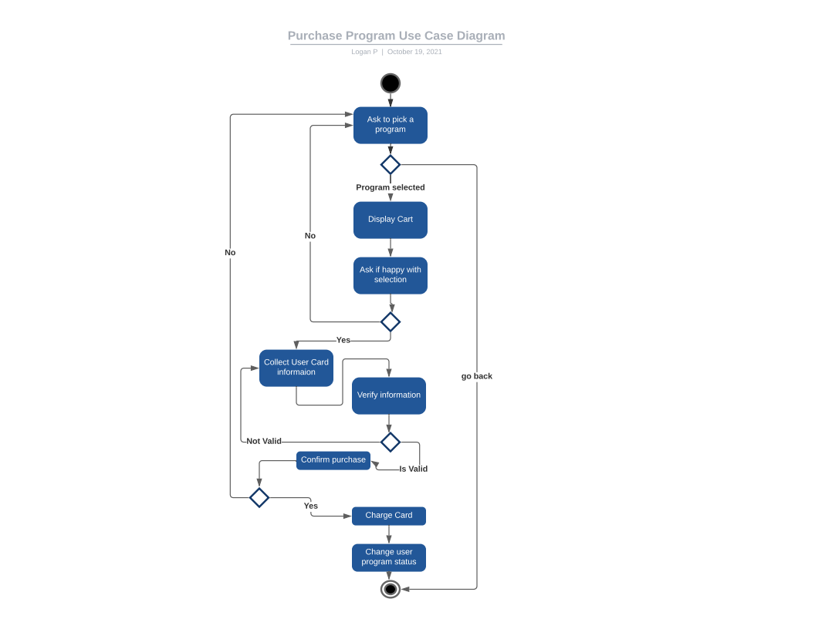
Activity Diagram
Notes:
In this diagram I am breaking down how the system should handle a student attempting to purchase a program. The flow shows you how the student interacts with the system, as well as how the system handles different input from the student. This shows how the system will be ready to handle a plethora of situations that will likely be thrown at it.
6

Slide 5
Users must have an account with:
Password (hash)
Phone-number/Email
Server will have Authentication
3rd party payment processes
Security
Notes:
Security is incredibly important for systems that are online. This is doubly so when money is involved. Because of this we have designed the Driver Pass system in a way that will be safe for the users, and secure from a server standpoint. Firstly, users must have a verified account to interact with the system. It will have a secure connection. Additionally, the server will not be easily accessible from the outside. Finally, the payment will be handled outside the system, and the system will not store payment information.
<number>

Slide 6
The system can only scale as fast as they can acquire instructors
The system can only be tailored to the laws in one state
Although small changes could be made to create a version for other states
System Limitations
Notes:
The Driver Pass system has the potental to become widely used, but it can only grow when the system has instructors to teach lessons This will likely be the largest bottleneck in term of growth. Additionally, the system is custom tailored to the laws in this state. So, if the system wanted to expand it would need to be customized for each state it would want to expand to.
Thank you!
<number>

